Slide 1
MINOR PROJECT:
Reinforcement Learning for Traffic Signal Control in SUMO
Submitted by:
Anand, 08217711922

Slide 2
INTRODUCTION TO PROJECT
The project leverages the Simulation of Urban MObility (SUMO) environment, a powerful open-source tool for microscopic traffic simulation.
The primary objective is to develop and implement both a Q-Learning and a Deep Q-Learning algorithm and rigorously compare their performance against a traditional static (fixed-time) traffic signal controller—for adaptive traffic signal control.
By evaluating metrics such as cumulative reward and total queue length, this analysis aims to demonstrate the significant advantages of adaptive, learning-based systems in optimizing urban traffic flow.

Slide 3

Simulation Environment and Network Configuration
Software Prerequisites:
SUMO (Simulation of Urban MObility): The core traffic simulation suite.
Visual Studio Code: A recommended Python IDE, though any preferred editor can be used.
Python: The programming language used to implement the reinforcement learning agents and interact with SUMO via the TraCI API(TraCI stands for Traffic Control Interface.It’s a Python (and C++) API that allows external programs to control and interact with SUMO (Simulation of Urban Mobility) in real-time.
Libraries required are Tensorflow, Numpy and Matplotlib.

Slide 4
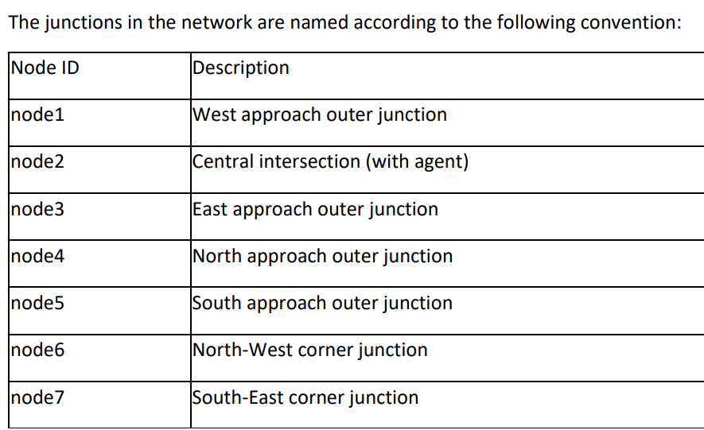
Network Construction in Netedit
The simulation network consists of a central, multi-lane intersection where the reinforcement learning agent will be deployed.
The network was constructed in Netedit by creating a series of junctions (nodes) and connecting them with edges (roads).
The primary roads were configured with two or three lanes in each direction to simulate a typical urban arterial, and all key roads were set for two-way traffic.
A 2 precise naming convention is essential for programmatically accessing these network elements later via the TraCI API.

Slide 5
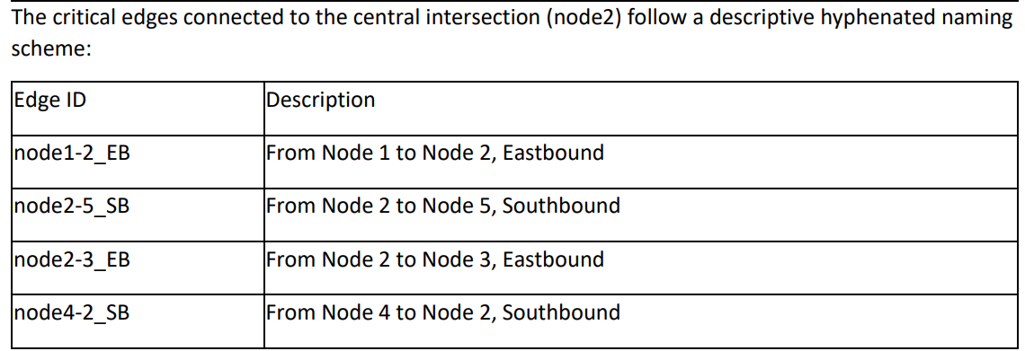
Network Construction in Netedit
For the purposes of this tutorial, the simulation utilizes SUMO's default vehicle types and traffic flow parameters. Specific routes were defined to generate traffic demand through the central intersection.

Slide 6
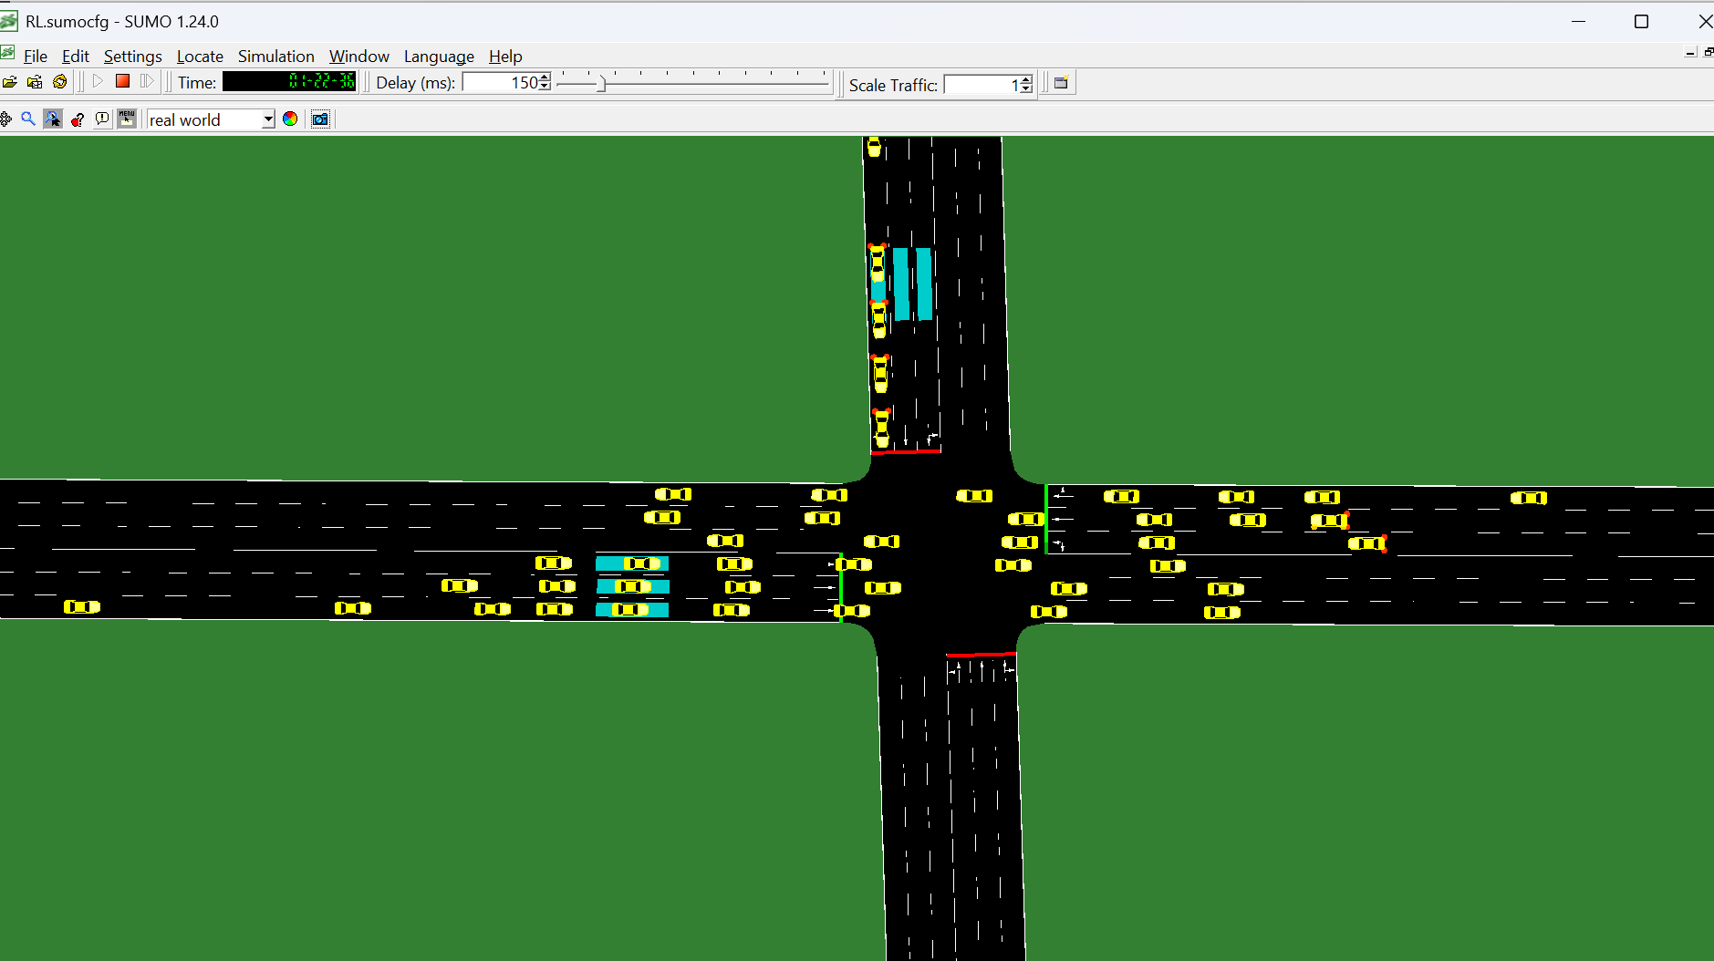
Network Construction in Netedit
Traffic Light Signal Configuration:
A traffic light signal was added to the central intersection (node2) to be controlled by the RL agent. The agent interacts with this traffic light using two primary TraCI functions:
• Value Retrieval: trafficlight.getPhase is used to query the current phase of the traffic light. This information is a critical component of the agent's state.
• State Changing: trafficlight.setPhase is used to command the traffic light to transition to a new phase. This is how the agent executes its chosen action.

Slide 7
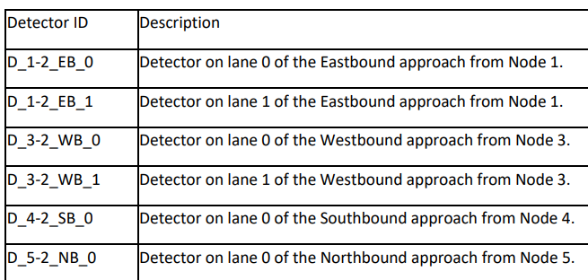
Network Construction in Netedit
Detector Placement and Configuration:
In this project, Lane Area Detectors (E2) are placed on the inbound lanes approaching the central intersection. These detectors measure key metrics like vehicle count and queue length within a defined area of the lane.
The agent retrieves data from these detectors using a specific TraCI function: lanearea.getLastStepVehicleNumber
This function returns the total number of vehicles that were within the detector's defined area during the last simulation step, providing a real-time measure of traffic density.
CODE:
# Detector IDs for Node1-2-EB
detector_Node1_2_EB_0 = "Node1_2_EB_0"
detector_Node1_2_EB_1 = "Node1_2_EB_1"
detector_Node1_2_EB_2 = "Node1_2_EB_2"
# Detector IDs for Node2-7-SB
detector_Node2_7_SB_0 = "Node2_7_SB_0"
detector_Node2_7_SB_1 = "Node2_7_SB_1"
detector_Node2_7_SB_2 = "Node2_7_SB_2"

Slide 8
Reinforcement Learning Framework Formulation
State Definition:
The state is a representation of the environment that the agent uses to make decisions. There are six lane area detectors placed on the approaches to the intersection. Therefore, the state vector contains six values representing the number of vehicles on each detector, plus a final value representing the current traffic signal phase.
Action Definition:
The action space defines the set of all possible moves the agent can make. To maintain simplicity and ensure stable learning, a discrete action space with two options is used:
Keep Phase (Action 0): The traffic light remains in its current phase for the next time step.
Switch Phase (Action 1): The traffic light transitions to the next phase in its predefined sequence (e.g., from Phase 0 to Phase 1).
Reward Function:
The reward function provides the feedback signal that guides the agent's learning process. The primary objective is to minimize the queue length at the intersection. To achieve this, the reward is formulated as the negative sum of all vehicles detected across all six lane area detectors at any given time step.

Slide 9
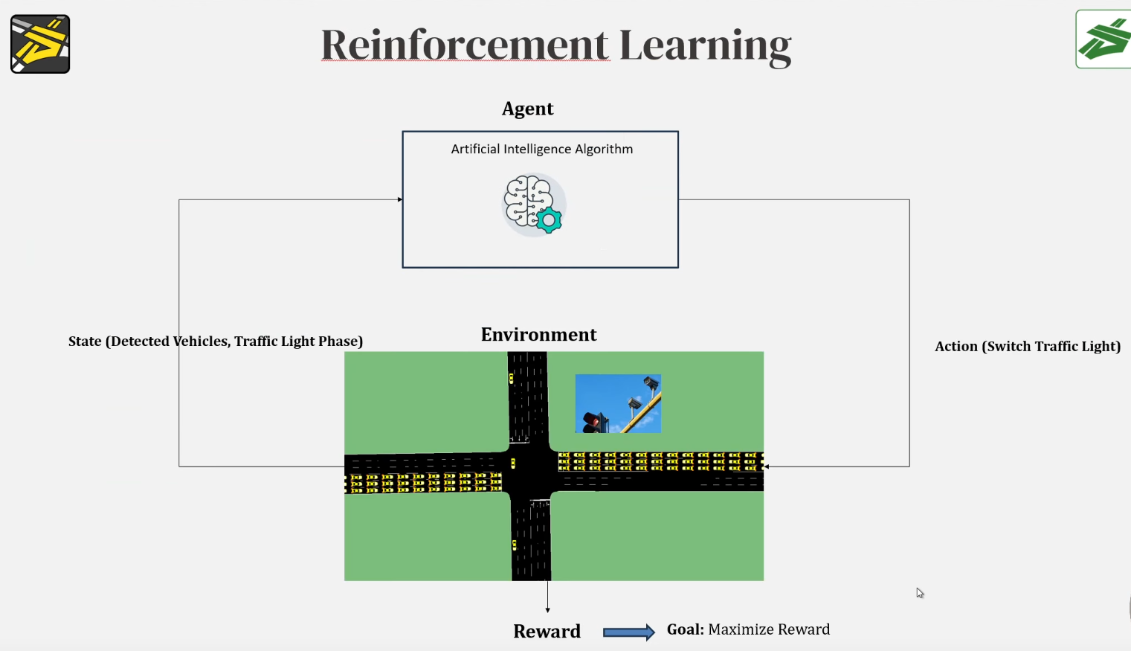
Reinforcement Learning

Slide 10
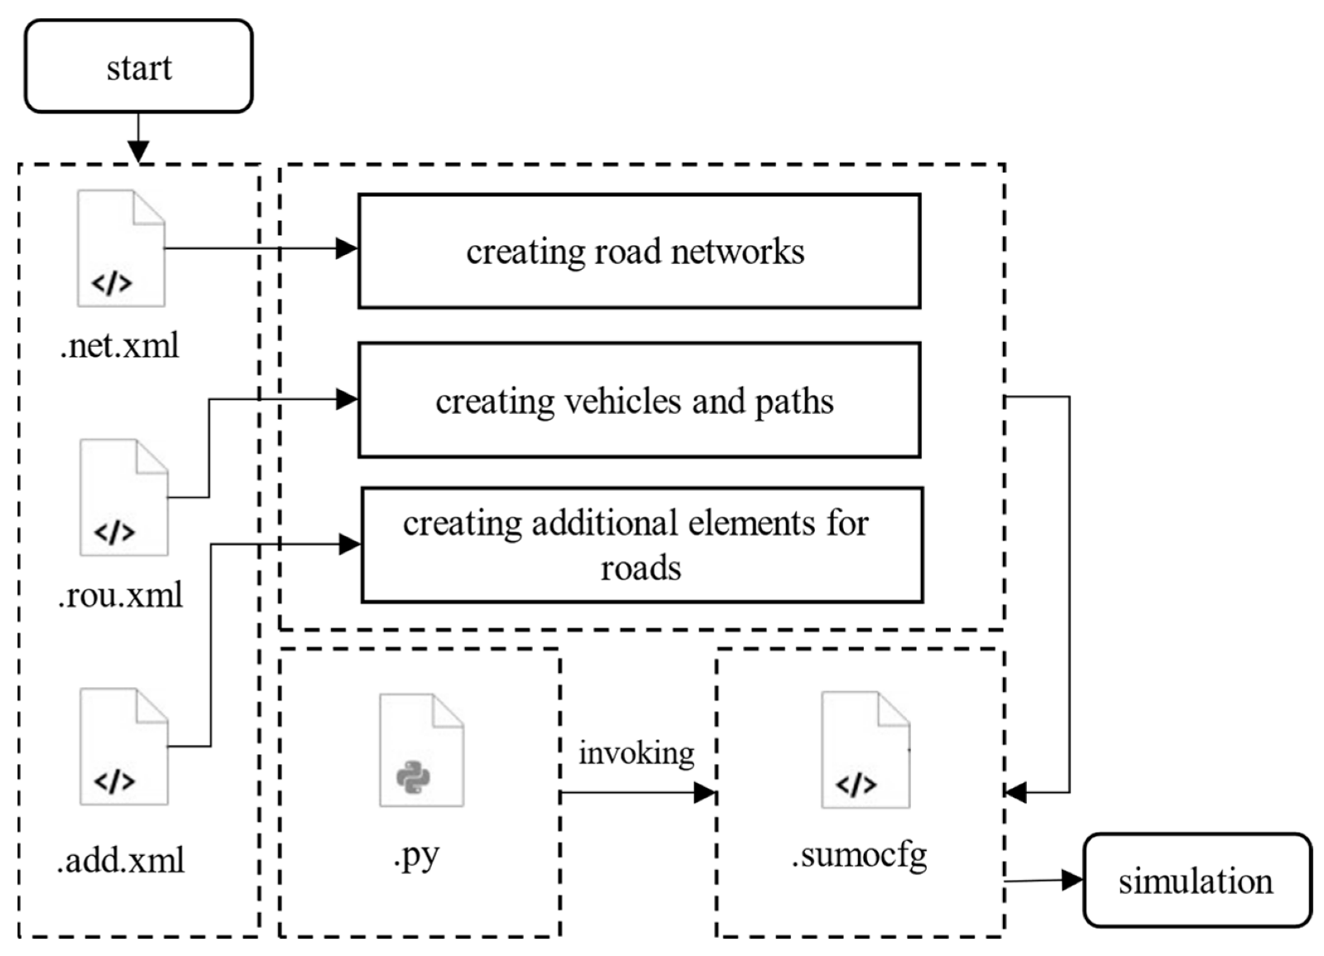
Reinforcement Learning

Slide 11
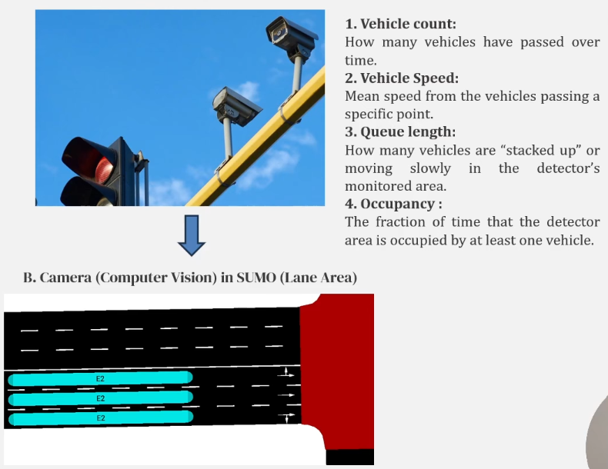
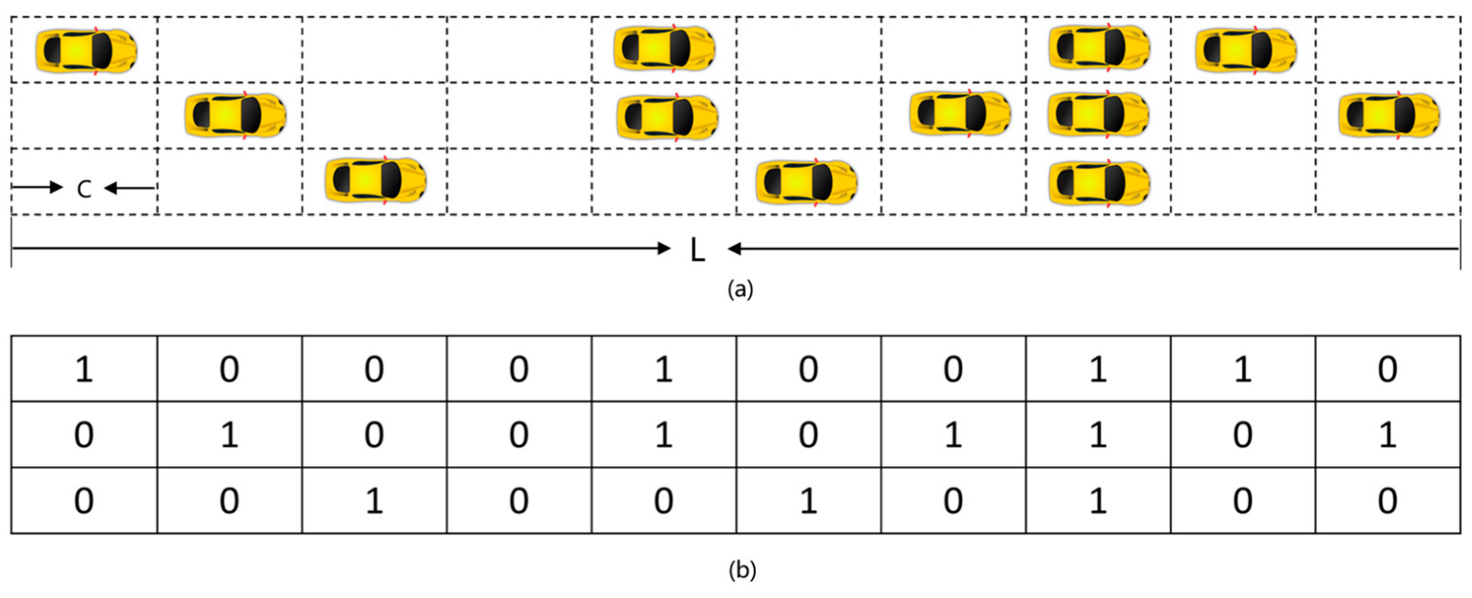

Reinforcement Learning
State

Slide 12
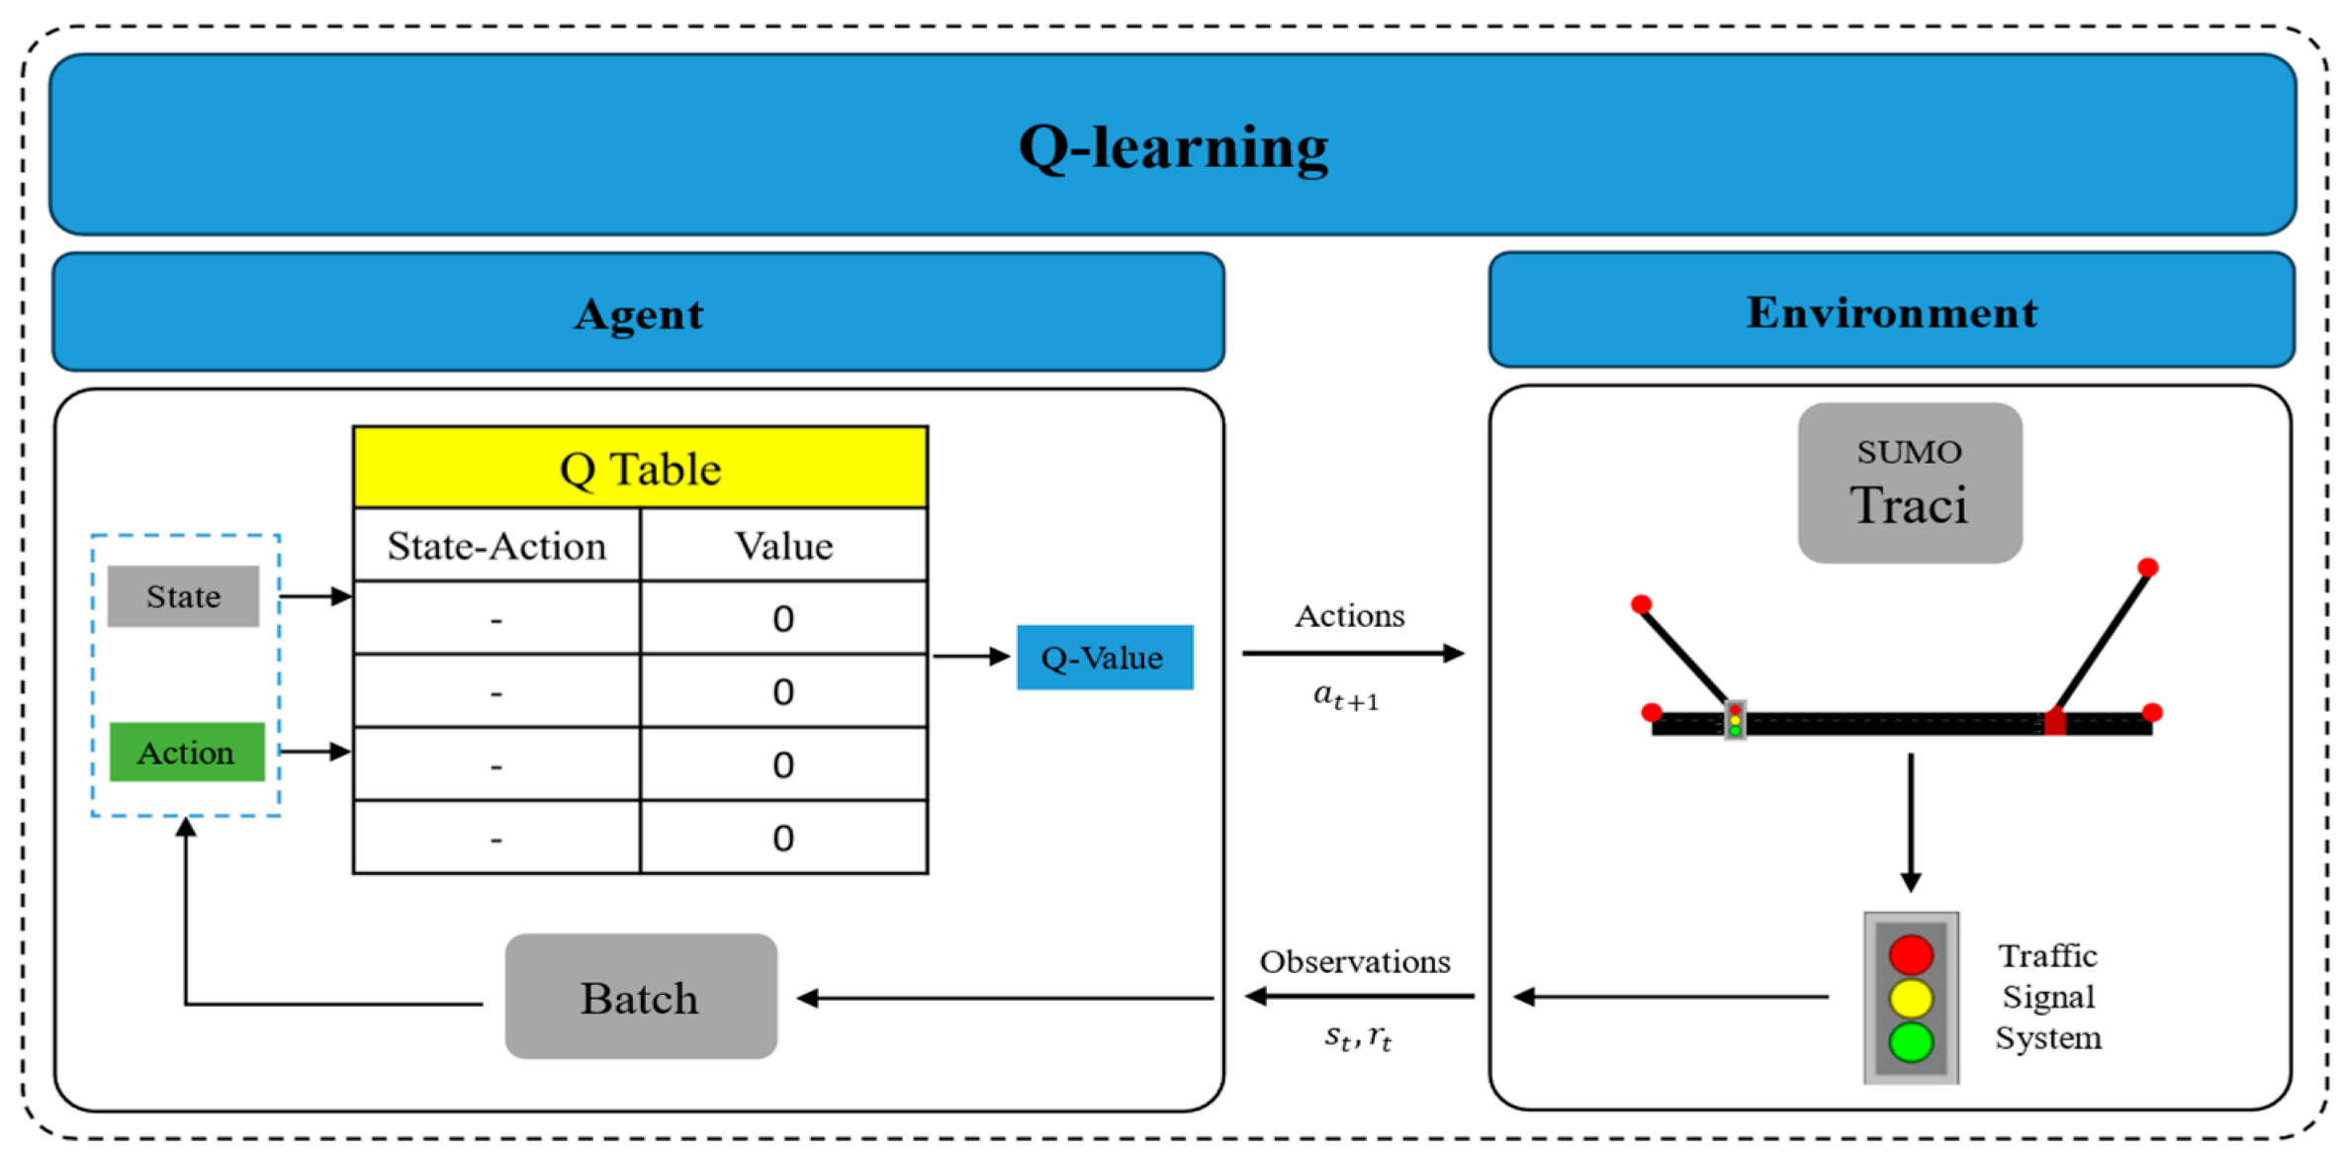


Reinforcement Learning
State

Slide 13
Algorithm 1: Q-Learning Implementation
Q-Learning is a foundational, model-free, value-based reinforcement learning algorithm.
Core Concept: The Q-table is a simple lookup table that stores the expected future rewards, known as Q-values, for each possible action in every state the agent has encountered. The rows of the table represent states, 5 and the columns represent actions.
The Q-learning update function is the mathematical heart of the algorithm. After the agent takes an action and receives a reward, this equation dictates how the corresponding Q-value in the Q-table should be updated based on this new experience.

Slide 14
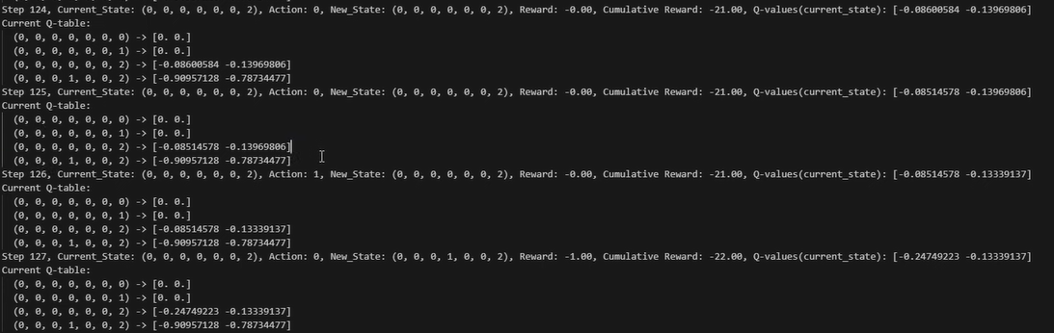
Algorithm 1: Q-Learning Implementation
So we are in step 124 and have below result:

Slide 15
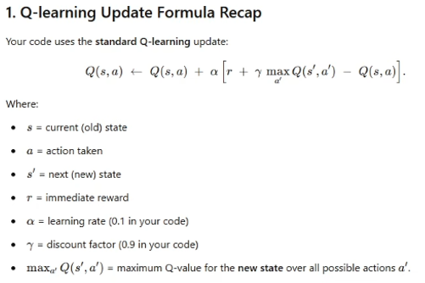
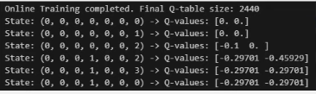
Algorithm 1: Q-Learning Implementation

Slide 16
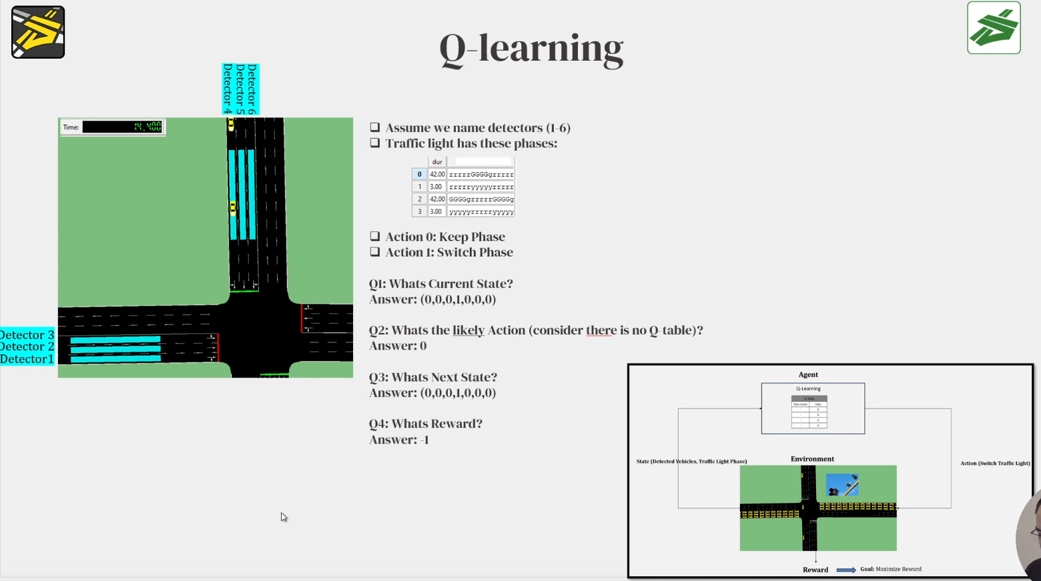

Reinforcement Learning
State

Slide 17



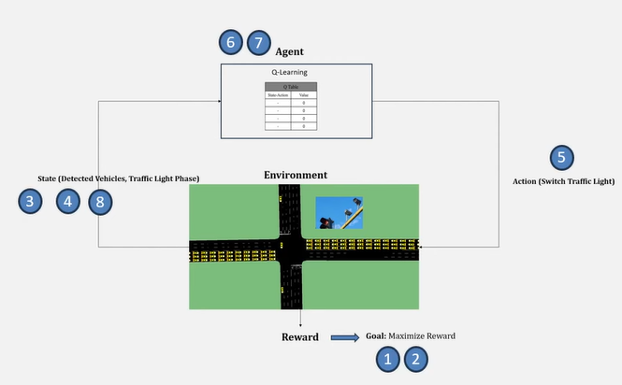
Q learning
Step |  | Explanation / Purpose
1. Objective |  | Goal: Maximize total cumulative reward over time
2. Reward Function |  | Reward = Negative total queue length (penalize long queues)
3. State Representation |  | State = Vehicle queues on each lane + current signal phase
4. Queue Dynamics |  | Each lane’s queue = old queue + arrivals − departures
5. Action (Traffic Light Control) |  | Action: either keep current phase or switch (respecting min green time)**
6. Q-Learning Update |  | Core learning rule: update expected return for current state-action
7. ε-Greedy Policy |  | Exploration: choose best action most of the time, random otherwise
8. Constraints |  | Ensure: Non-negative queue, valid phase index
9. SUMO Integration | — | All traffic variables (queues, arrivals, departures, phases) are obtained from SUMO via TraCI API

Slide 18
Results and Comparative Analysis
Q-Learning vs. Fixed-Time Control:
Cumulative Reward: Over the course of the simulation, the fixed-time controller achieved a final cumulative reward of approximately -6,0000. In contrast, the Q-Learning agent achieved a significantly better reward of approximately -25,000.
Total Queue Length: The fixed-time controller exhibits high volatility, with queue lengths frequently fluctuating between 0 and 12 vehicles. The Q-Learning agent, however, maintains a much more stable and consistently lower queue length, generally keeping it between 0 and 5 vehicles.

Slide 19
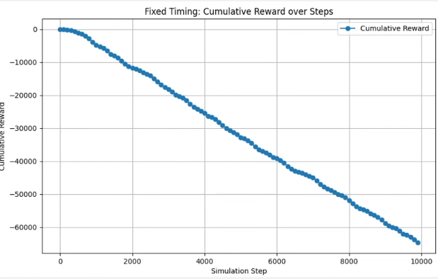
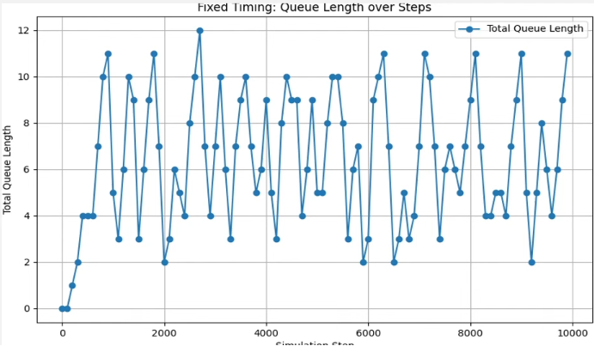
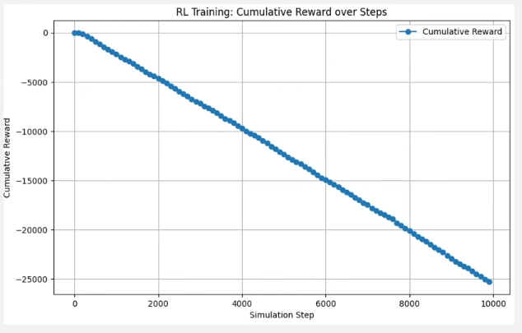
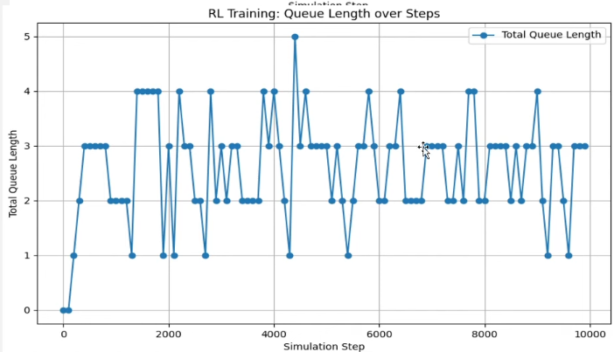
Results

Slide 20
Recommendations for Further Analysis
To build upon this foundational work, several extensions are recommended to increase the project's realism and analytical depth:
• Real-World Application: Transition from a generic intersection to a real-world location. This can be achieved by creating SUMO roads on a GIS map and incorporating open data for realistic traffic volumes and patterns.
• Enhanced Vehicle Fleet: Instead of using a single default vehicle type, introduce a more diverse fleet that includes different vehicle classes such as passenger cars and taxis, each with unique behavioral characteristics.
• Adding deep q learning: Incorporating deep q learning to enhance the traffic flow.
• Hyperparameter Tuning and Optimization: Conduct a sensitivity analysis on the core reinforcement learning parameters. Systematically tuning these values can further optimize agent performance and reveal insights into the learning dynamics for this specific problem.

Slide 21
References
P. Santhiya, I. J. Jebadurai, G. J. L. Paulraj, J. A, G. R. A and S. K. Karan, "ITS-AI Integration: Enhanced Strategies for Mitigating Urban Traffic Congestion," 2024 5th International Conference on Recent Trends in Computer Science and Technology (ICRTCST), Jamshedpur, India, 2024, pp. 376-381, doi:10.1109/ICRTCST61793.2024.10578453.
Genders, W., & Razavi, S. (2016). Using a deep reinforcement learning agent for traffic signal control. arXiv preprint arXiv:1611.01142.
Liu, X. Y., Zhu, M., Borst, S., & Walid, A. (2023). Deep reinforcement learning for traffic light control in intelligent transportation systems. arXiv preprint arXiv:2302.03669.
Swapno, S. M. M. R., Nobel, S. M. N., Meena, P., Meena, V. P., Azar, A. T., Haider, Z., … & Tounsi, M. (2024). A reinforcement learning approach for reducing traffic congestion using deep q learning. Scientific Reports, 14(1). https://doi.org/10.1038/s41598-024-75638-0
Cai, C. and Wei, M. (2024). Adaptive urban traffic signal control based on enhanced deep reinforcement learning. Scientific Reports, 14(1). https://doi.org/10.1038/s41598-024-64885-w
Li, M., Pan, X., Liu, C., & Li, Z. (2025). Federated deep reinforcement learning-based urban traffic signal optimal control. Scientific reports, 15(1), 11724. https://doi.org/10.1038/s41598-025-91966-1
Bouktif, S., Cheniki, A., & Ouni, A. (2021). Traffic Signal Control Using Hybrid Action Space Deep Reinforcement Learning. Sensors (Basel, Switzerland), 21(7), 2302. https://doi.org/10.3390/s21072302
Ravindran, S. K. T., Balachandran, G. B., & David, P. W. (2025). Measurement and analysis of heterogeneous road transport parameters using smart traffic analyser and sumo simulator: an experimental approach. https://doi.org/10.1016/j.measurement.2024.116233
Son, S., & Jin, J. (2024). Applying Reinforcement Learning to Optimize Traffic Light Cycles. arXiv preprint arXiv:2402.14886.
Dataset:https://www.kaggle.com/datasets/rawsi18/new-delhi-traffic-probe-and-analytics-2024
Code:https://github.com/Yashh772/minor-project-7th-semester

